Slide 1
Physics Based Throwing
Using Inverse Dynamics Control
6.4210 Final Project
Hanqi Su, Quincy Johnson, Arif Kerem Dayi
2022.12.13

Slide 2
OUTLINE
1 PROJECT GOAL
2 INTRODUCTION & BACKGROUND
3 SYSTEM DESIGN
4 METHODOLOGY & IMPLEMENTATION
5 EVALUATION
6 DISCUSSION & FUTURE WORK

Slide 3
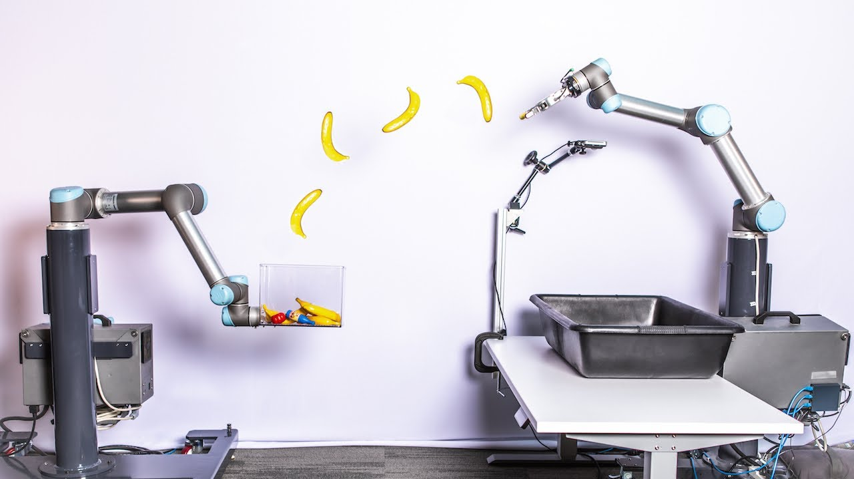
MOTIVATION & BACKGROUND
Throwing objects is a very important skill to endow robots with, as it is a prerequisite for more complex and dynamic robotic manipulation tasks.
Can increase the efficiency of manipulation and extend robots' workspace
Zeng, Andy, et al. "Tossingbot: Learning to throw arbitrary objects with residual physics." IEEE Transactions on Robotics 36.4 (2020): 1307-1319.

Slide 4
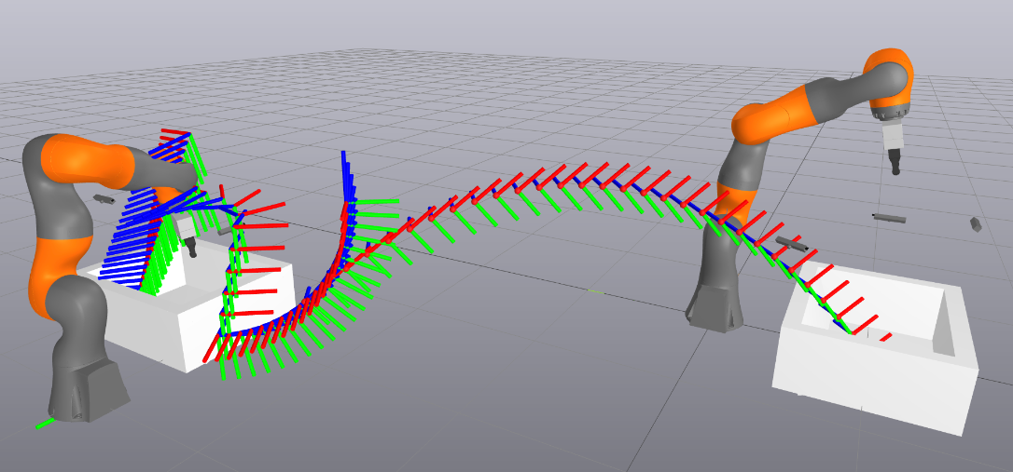
PROJECT GOAL
Throwing is an important primitive actions that can make manipulation faster, and extend robot's workspace.
Construct a method for robots to successfully throw objects between one another.
=> Perception + Grasping + Trajectory Planning + Inverse Dynamics Control

Slide 5


Slide 6
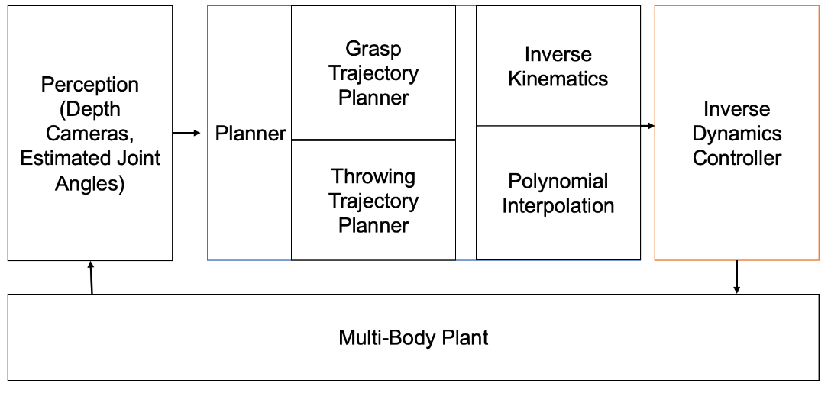
SYSTEM DESIGN
perception & grasp selection
throwing trajectory plan
inverse kinematics to convert 3D poses into joint angles
inverse dynamics to achieve precise trajectory control

Slide 7
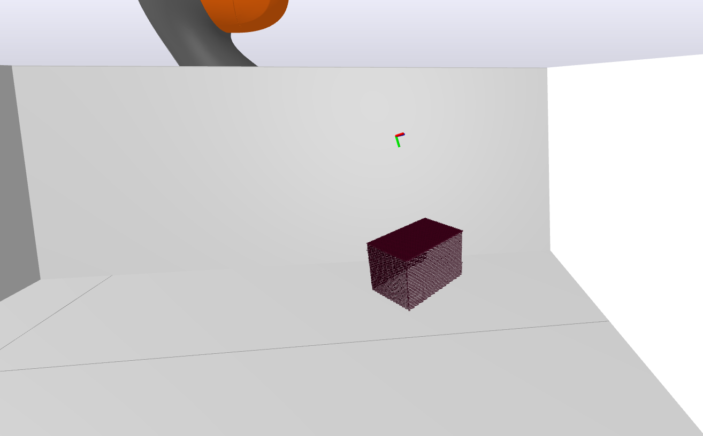
METHODOLOGY - Perception & Grasp Selection
Point Clouds sampled from cameras. Combined and Down sampled.
Normals for points found and oriented towards camera
Grasps scored based on quality of grasp.
Gripper pose of best grasp returned

Slide 8
METHODOLOGY - Trajectory Planning
Complete throwing trajectory consists of 3 parts
Rotation Part
Linear Movement Part
Circular Throwing Part
Notes:
rotate the robot arm to the orientation direction. After the first step, move linearly from the current position to the starting position of the throwing trajectory. Third, generate the last segment of the throwing trajectory using our self-designed circular throwing trajectory method.

Slide 9
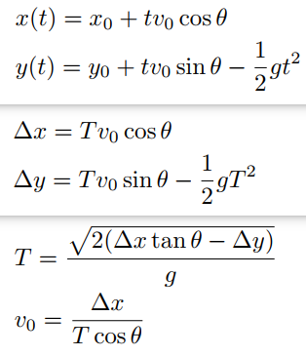
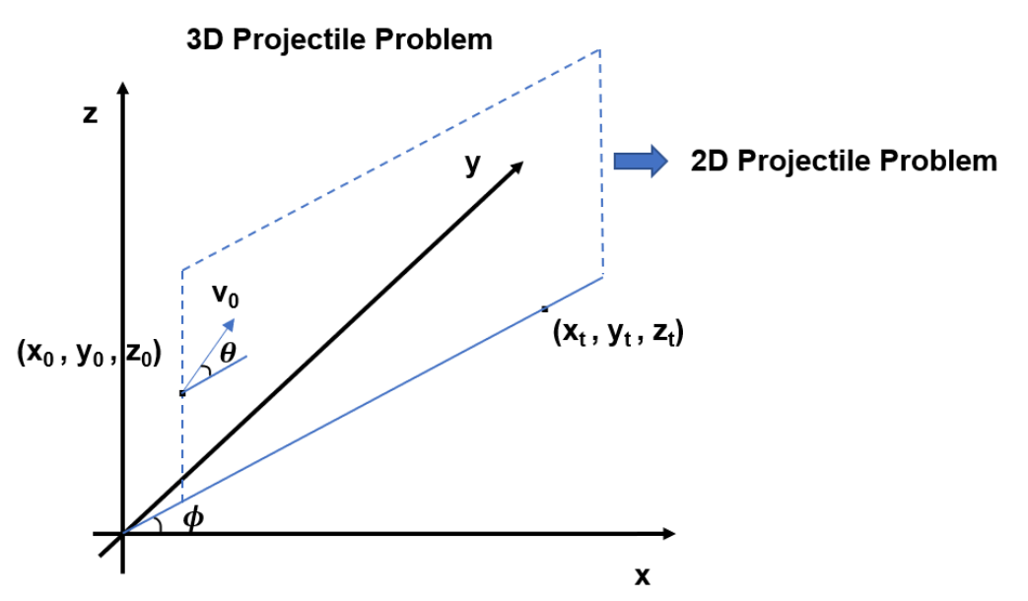
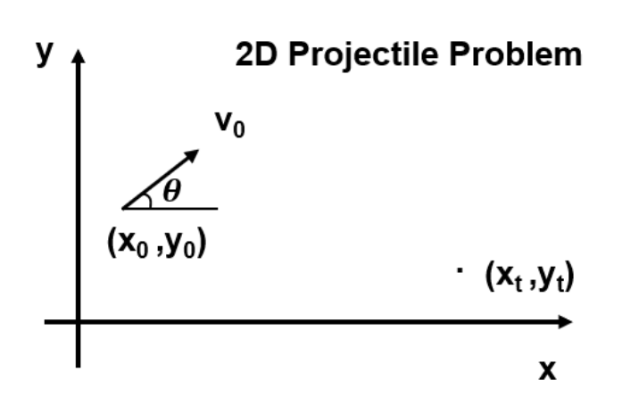
METHODOLOGY - Projectile Problem
2D Projectile Problem <--------------------- 3D Projectile Problem
Notes:
Returning to our throwing problem, although our robot is throwing the object in a 3D world, we can reduce this throwing behavior to a two-dimensional problem. As you can see in the right figure, when the robot is heading towards the target point, we can set the throwing trajectory in the direction of the target point.

Slide 10
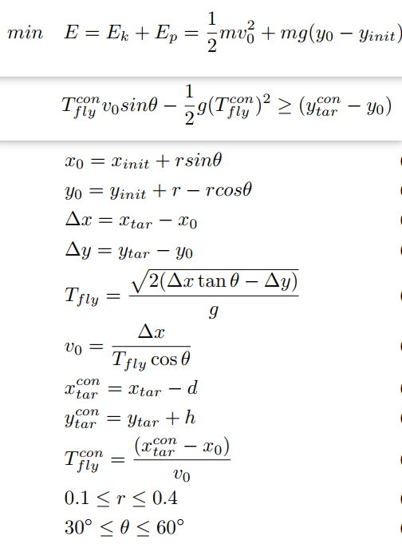
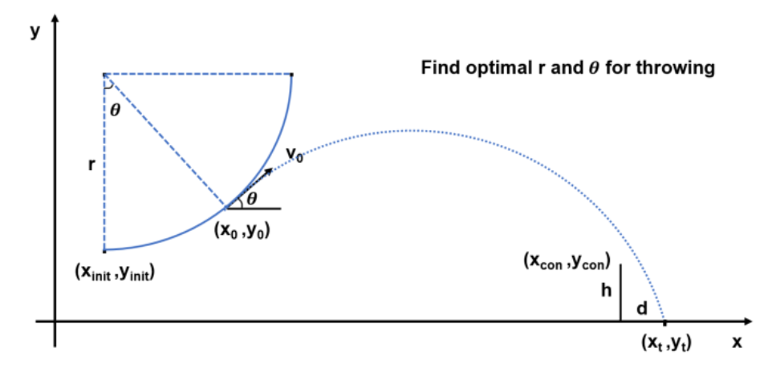
METHODOLOGY - Trajectory Planning
Minimum Energy Consumption Trajectory
Notes:
We use Minimum Energy Consumption Trajectory, which is a circular arc trajectory design idea. Considering left Figure, since we know the starting position of the throwing trajectory, the core of our solution is not to find the throwing position and velocity directly, on the contrary, We should focus on the radius of the arc and the launched angle.The right side is the cost function and related constraints.

Slide 11

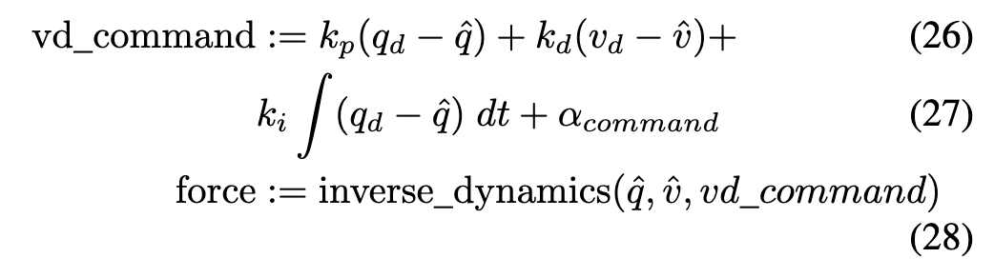
METHODOLOGY - Inverse Dynamics Control
Throwing -> Large accelerations & velocities
Naive controlers are NOT aware of system dynamics
lag behind
Need to incorporate velocity / acceleration
inverse dynamics control
IK to generate joint angle steps
Shape preserving interpolation to generate joint trajectories
Use derivatives of the interpolation to generate velocities & accelerations
Notes:
Since throwing is a dynamic task, it involves large acceleratoins and velocities and we need to be able to track velocities as well as position.

Slide 12
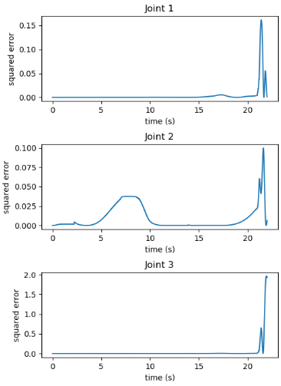
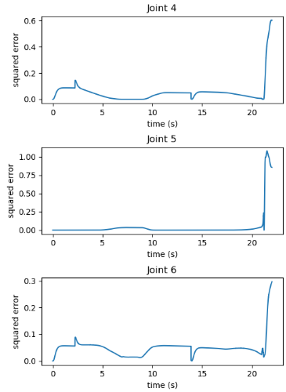
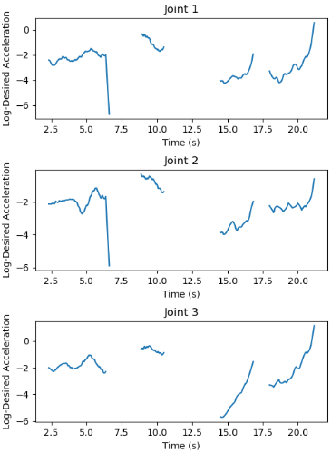
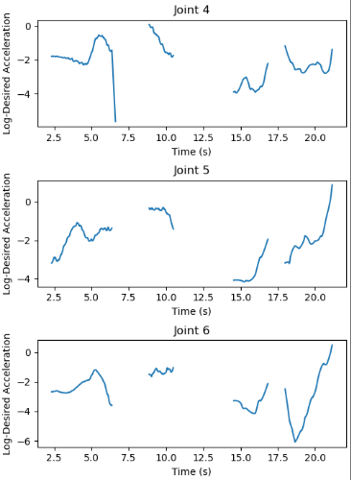
EVALUATION - Controller Performance
Testing Trajectory Tracking Performance (throwing happens around time 21)
Tracking Error Over Time
Desired Acceleration Over Time (log scale, smoothed)

Slide 13
Failed Throws (Need for Robust Grasp)
Notes:
In this example, the throw goes too far, we think it is because the object swings due to the grasp position. Swinging makes the object go further than expected.

Slide 14
DISCUSSION & FUTURE WORK
When is throwing successful ?
robust grasp, limited acceleration, achieving desired velocity
What makes a controller successful → limitations of Inverse Dynamics
Possible improvements
dynamic trajectory optimization
system level
Why do we need learning based approaches ?
Notes:
When is throwing successful -> robust grasp, object doesn't slip or swing. Limited acceleration, desired velocity. These challenges make learning based approaches even more compelling, since they promise to generalize to a variety of grasps and the controller is optimized for throwing accuracy. Can overcome system level challenges.
the grasp is robust → the object doesn't slip, or swing

Slide 15
Thank you !
Hanqi Su, Quincy Johnson, Arif Kerem Dayi
2022.12.13

